Slide 1
Presentation title
Mirjam Nilsson

Slide 2
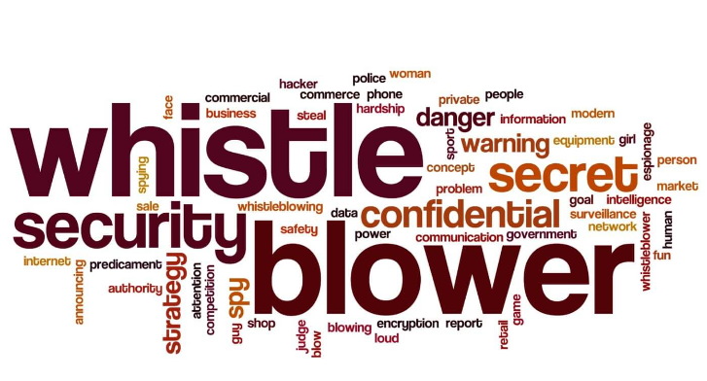
Whistle blowing defined: We empower organizations to foster collaborative thinking to further drive workplace innovation. By closing the loop and leveraging agile frameworks, we help business grow organically and foster a consumer first mindset.
Examples of situations where whistle-blowing may occur include:
1. Corporate Fraud
2. Safety Hazards
3. Environmental Pollution
4. Government Corruption
5. Healthcare Misconduct
6. Academic Misconduct

Slide 3
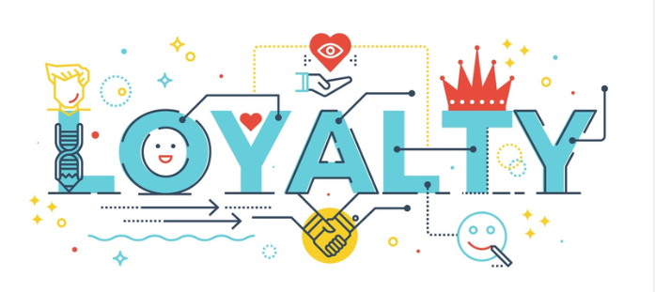
Loyalty Defined: Loyalty is a sense of commitment, allegiance, or devotion to a person, group, or cause. In the context of organizations, loyalty is an important characteristic that is valued by employers and often expected of employees
The role of loyalty in organizations can be seen in various ways:-
1. Employee Retention
2. Productivity and Performance
3. Company Culture
4. Brand Reputation

Slide 4
Balancing Whistle-blowing and Loyalty:
Employees can balance whistle-blowing and loyalty by understanding their company's policies, weighing the consequences, seeking guidance, being objective, maintaining confidentiality, and being prepared for potential consequences. Ultimately, it is important for employees to act in the best interest of the organization and the greater good, while also protecting their own interests and well-being.

